Slide 1
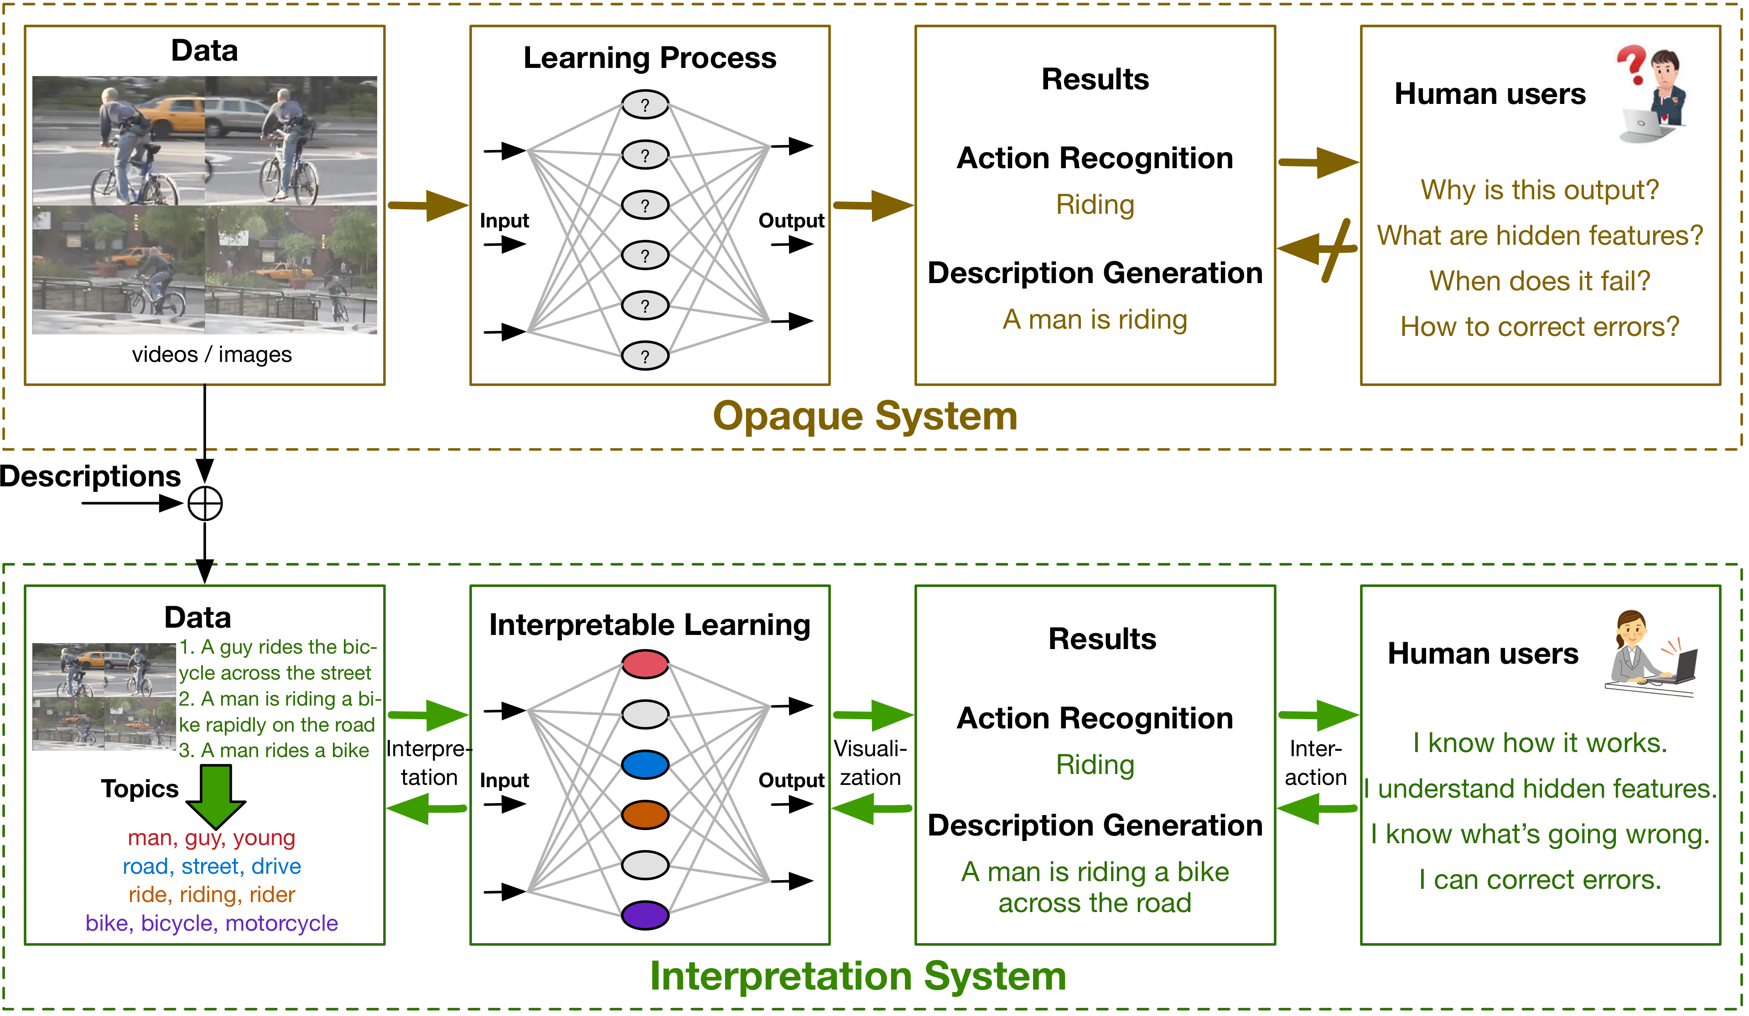
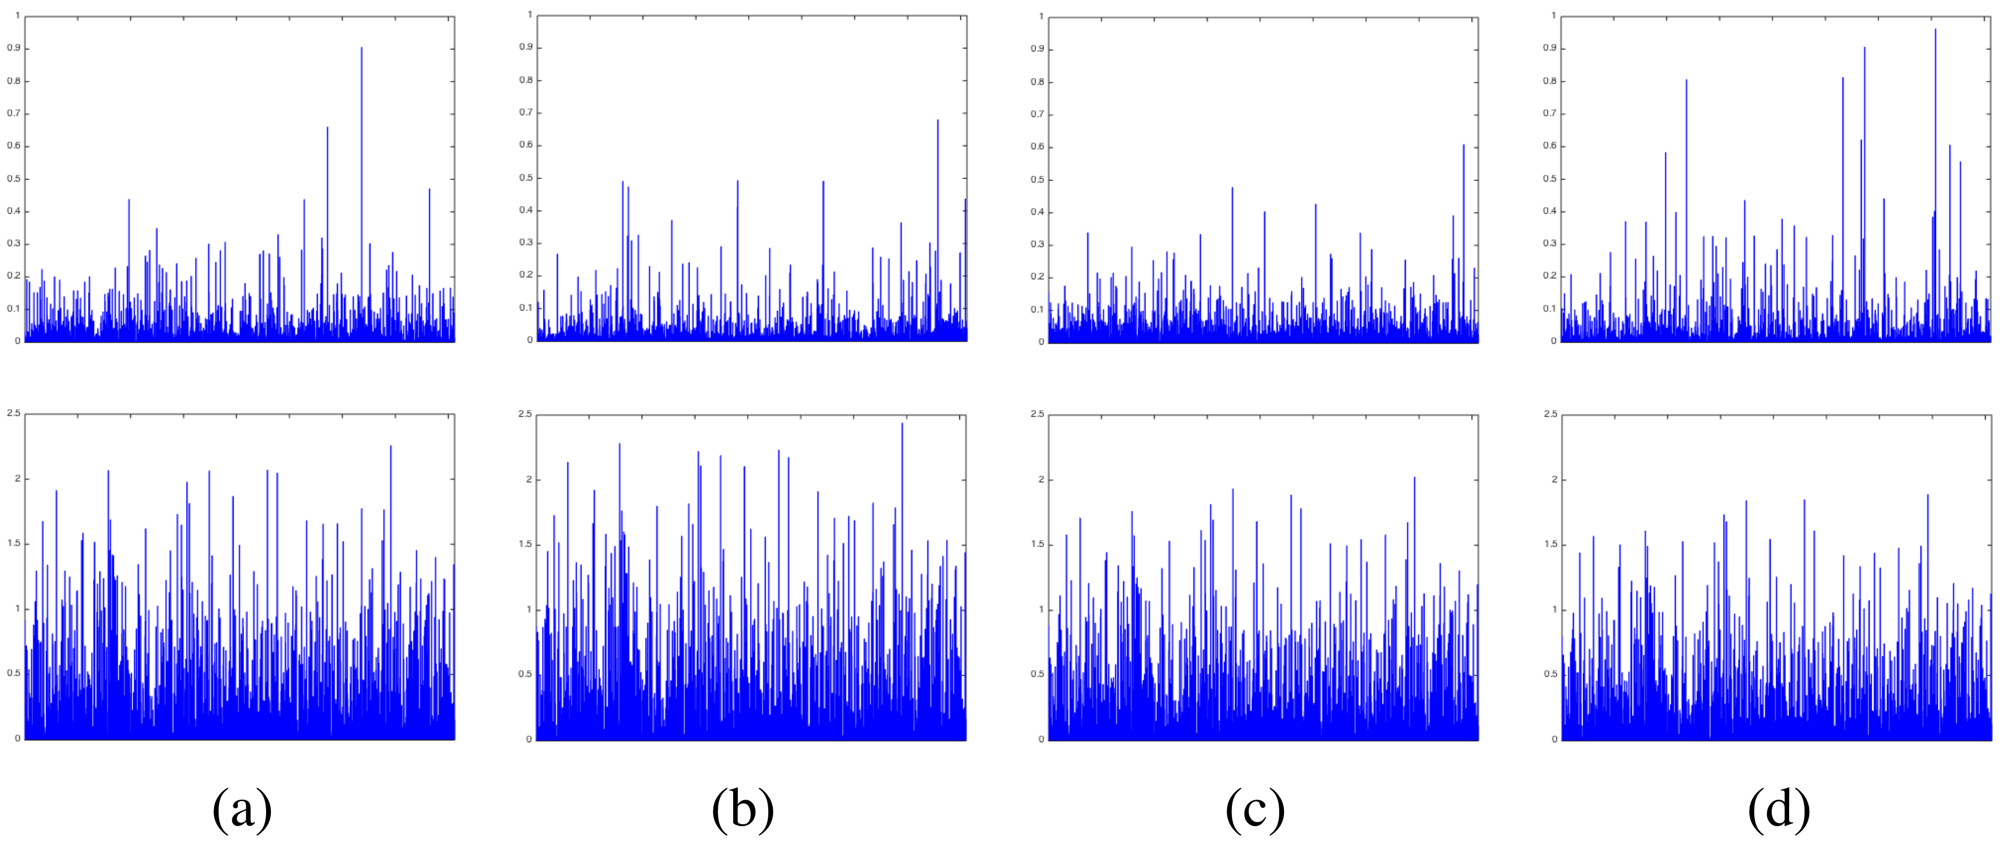
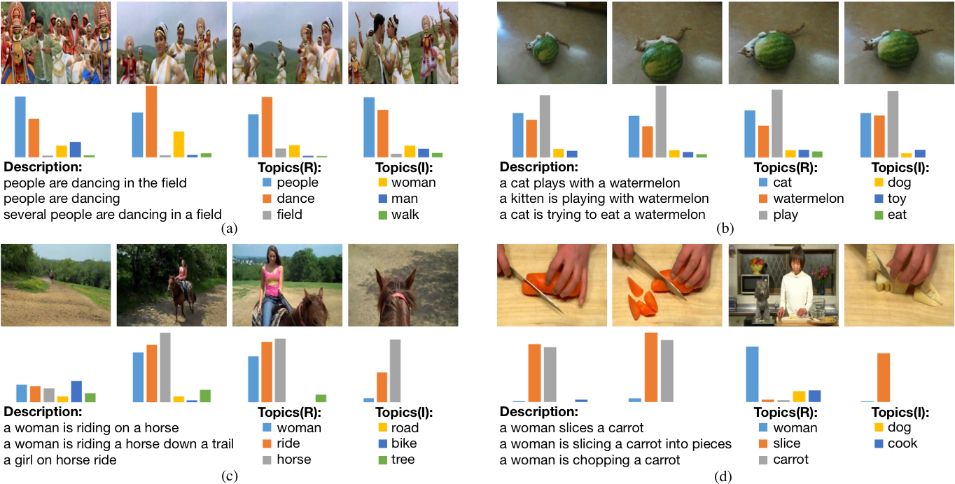
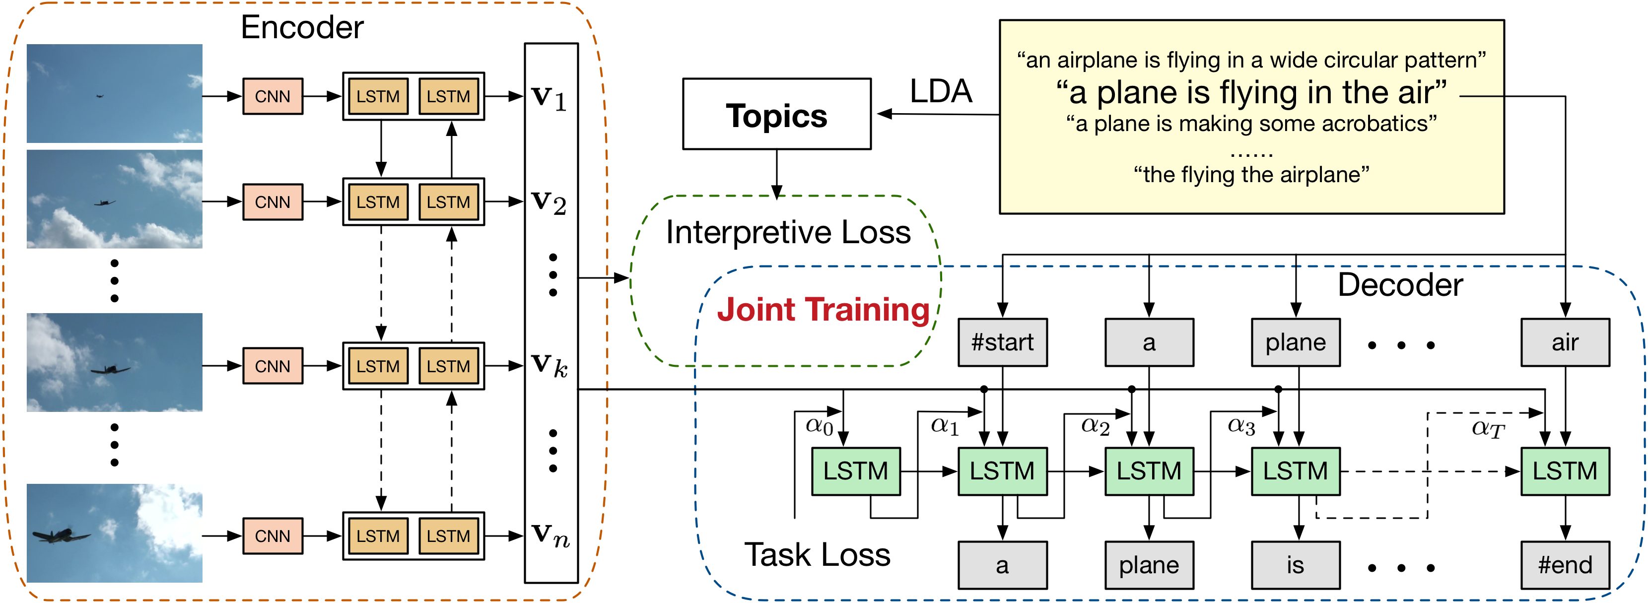
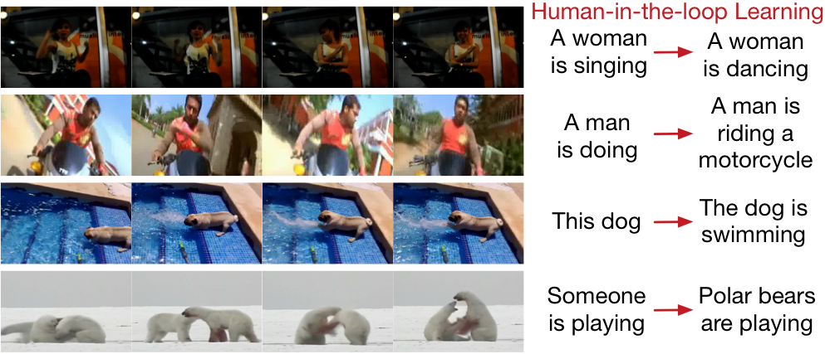



Improving Interpretability of Deep Neural Networks
with Semantic Information
Yinpeng Dong, Hang Su, Jun Zhu, and Bo Zhang
Department of Computer Science and Technology, Tsinghua University
INTRODUCTION
Interpretability of deep neural networks (DNNs) is essential since it enables users to understand the overall strengths and weaknesses of the models, conveys an understanding of how the models will behave in the future, and how to diagnose and correct potential problems. However, it is challenging to reason about what a DNN actually does due to its opaque or black-box nature.
In this work, we propose to
Incorporates the interpretability of hidden features during training;
Leverage the semantic information embedded in human descriptions;
Interpret the neurons by a prediction difference maximization algorithm;
Introduce a human-in-the-loop learning procedure.
RESULTS
Prediction Difference Maximization:
$$j_{i}^{∗}=\arg{\max_{j}{({\left[f\left(v\right)\right]}_{i}−{[f(v_{\backslash j})]}_{i}}}$$
Human-in-the-Loop
Get human users involved in the learning process; Embedding human knowledge into the model; Correct system‘s mistakes
For an inaccurate prediction, users provide missing topic t
Activation enhancement
Correction propagation: $L_{human}={\left\|v^{′}−v^{∗}\right\|}_{2}^{2}+μ{\left\|θ^{′}−θ\right\|}_{2}^{2}$
METHOD
Attentive encoder-decoder framework
Encoder: GoogLeNet + Bi-directional LSTM
Decoder: Attentive LSTM
Interpretive Loss
Topics extracted from descriptions by LDA
$L_{I}\left(V, s\right)={\left\|f\left(\frac{1}{n}\sum_{i=1}^{n}{v_{i}}\right)−s\right\|}_{2}^{2}$
Training:
$$L=\sum_{t=1}^{N_{s}}{\log{p\left(y_{t} | y_{<t},x,θ\right)}+λ}{\left\|f\left(\frac{1}{n}\sum_{i=1}^{n}{v_{i}}\right)−s\right\|}_{2}^{2}$$
CONCLUSIONS
A novel technique to improving interpretability during training;
We simultaneously improve the interpretability of the learned features and achieve better performance;
Propose a prediction difference maximization algorithm;
Introduce a human-in-the-loop learning procedure

